Slide 1



Iowa-Grant’s
1st Year using Microsoft Intune for Education
The Good, Bad & OMG!
Stephanie Dirks &
Dan Steinbach
Iowa-Grant School District
Christopher Urban
Sr. Program Manager
Microsoft

Slide 2
Agenda
Iowa-Grant School District
Where Together We Make a Difference
        Background
        Microsoft Solution
        Iowa-Grant’s Implementation
        Good
        Bad
        OMG

Slide 3

Intune for Education
Overview and Update

Slide 4




Information Technology Goals
Improved student outcomes
Teacher time
savings
Lower total cost of ownership
Simplified IT management
Notes:
Taken from M365 Education AT TEI Study – Exec Deck
The study featured financial and educational impacts of Microsoft 365 Education, and we grouped their findings into these four over-arching buckets.

Slide 5


Transitioning To Modern Management
Traditional IT
Modern IT
Single device
Institution owned
School network (on-prem) & legacy apps
Manual
Reactive
High-touch
Multiple devices
User and institution owned
Cloud managed & SaaS apps
Automated
Proactive
Self-service
&
vs.
Notes:
But the reality is we are also still living in a world that still has a lot of traditional IT. And there is real tension here.
IT departments have built themselves around the traditional PC lifecycle, managing images, controlling updates, locking down behavior, protecting users.
But IT needs to evolve and adapt.
<click for build>
We don’t think this should be an either/or. Our approach is to allow you to do both, and to modernize at your own pace, to manage risk in a smart way. To take advantage of the cloud and modern IT, but also give you the tools and capabilities to bring that that design point to your existing investments so you aren’t throwing everything out.
Key points to land
Classic v modern IT ‘tension’
Do both. Modernize at your own pace, manage risk
Take advantage of the cloud but also bring that design point to your existing investments.
“The reality is there is real tension in IT”

Slide 6



Microsoft Endpoint Manager
Transformative management and security
Enable
your users
Protect
your data
PC desktop
management
Mobile device management
Mobile application management
Notes:
In case you missed it, we announced the Microsoft Endpoint Manager at Ignite Orlando. It meets you wherever you may be in the Management journey. If you are ready for cloud only -> go there but if you are not there yet, you can use co-Management as long as you like. It is a destination. Get the maximum out of cloud-attach and improve the security posture of your organization.

Slide 7
Configuration Manager
and
Microsoft Intune
Secure and intelligent
Streamlined
and flexible
Maximizes investment
Notes:
Secure integrated solution. It adds the security and intelligence from the cloud to your existing on-prem and mobile environment.

Slide 8
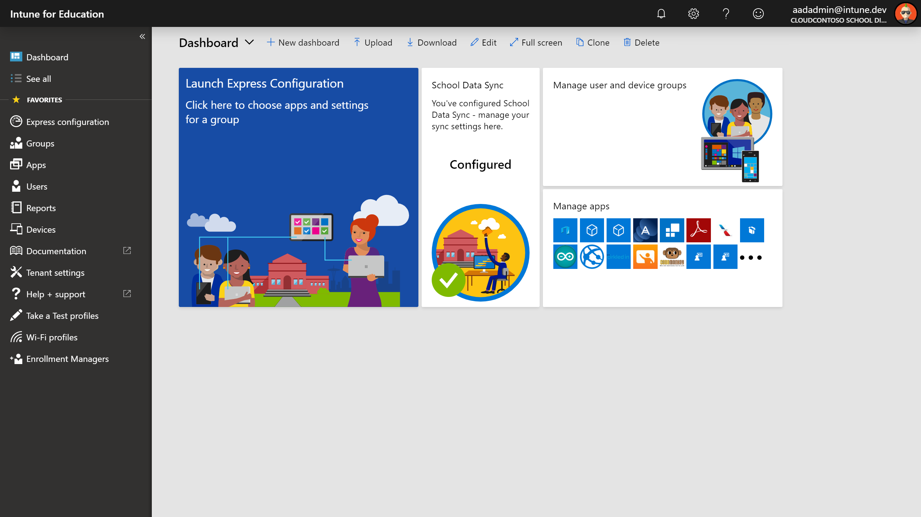
Intune for Education
A simpler way to deploy and manage classroom devices
Simple enrollment
  Bring devices under management simply by AAD joining or using Company Portal
Easy deployment
  Full IT service or delegate with USB setup key
Zero touch management
  Apps and settings applied to each enrolled device by default
Easier shared device management
  Each user can get different settings/apps if required
Designed for Education
  Easy to use for common school scenarios and settings
Import school, student and teacher info quickly
  Use School Data Sync to automatically create classes and keep student data up-to-date

Slide 9

FastTrack for Microsoft 365
Your partner for Microsoft 365 success
Onboard to Microsoft 365 services and migrate your data
Deploy chat-based collaboration and productivity apps
Enable identity, device management, and modern security
New! Application compatibility services for modern desktop
Gain customer user adoption and realize business value
Delivered by Microsoft engineers or approved partners
Included in your eligible subscription at no additional cost
www.microsoft.com/FastTrack

Slide 10

Iowa-Grant Managing with Microsoft Intune
First Year’s Journey

Slide 11
Iowa-Grant IT Challenges
(Before Intune for Education)
IT Team 1.5
1:1 iPads (2-8)
1:1 Windows laptops (9-12 & staff)
600+ Windows devices
0 Chromebooks
Struggled with offsite authentication & device management
GSUITE & MS Office A1 & Azure Premium
Students complain about login difficulties and slowness especially offsite
Wondering if keeping the Windows experience is worth the headache
IT Staff considering Chromebooks because of management
BrainStorm 2019s purpose for IG was to figure out if there was a way to manage Windows devices in a somewhat intuitive & cost effective manner.

Slide 12
Before Intune ~ 2018-2019
eDirectory
Local file structure (H:\ & S:\)
Google's File Stream (G:\)
Zenworks Desktop Management
eDirectory <-> AD -> Azure (users/passwords)
eDirectory -> Google (users/passwords)
Little to no use of One Drive
SIS DataSync to Azure - not using
Wired Machines
Authenticated with eDirectory
Housed & Managed w/ ZenWorks
Local file directories (H:\ & S:\)
Google File Stream (G:\)
Mobile
Authenticated with Azure AD
ZenWorks Management
Drive File Stream (G:\)
1

Slide 13
Intune 2019-2020
Local AD
Local AD <-> Azure Active Directory (users/passwords)
Local AD-> Google (users/passwords)
No local file directory
Google File Stream G:\ Drive
Little to no use of One Drive
Little to no use of Data Sync
Devices
Authenticate with Azure AD
"Live/Located" in Azure AD
Managed with Intune
Drive File Stream (G:\)
1

Slide 14
How did you start?
Iowa-Grant would not be using Intune if it wasn't for BrainStorm 2019 and meeting Chris. Microsoft does not make it easy.....
Prior to Implementation
Transitioning to Google for staff/student directories
AD syncing with Azure AD (AD Connect)
Logging into Google & Microsoft exactly the same (user doesn't recognize difference)
SIS Data Sync
1

Slide 15


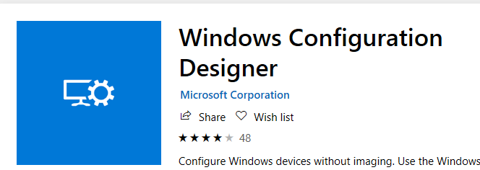
The Good
Azure Support (Mario), Fast Track (Phil) & Chris' Check-ins
Device Enrollment
Device: Administrator or Standard User
Authentication
Device Restrictions
App Installation – MSI & Web Clips (urls)
Device Office Licensing (2016)
Windows Imaging & Configuration App for Provisioning (join/name/WIFI)
"Global" policy enforcement – off/on site – it works
Implement new features (Bitlocker/Edge Chromium)
Support tickets ~ good response time
15

Slide 16

Bad ~ Really Just Annoying
Navigation ~ too many portals (they're working on this)
Refreshing of Device Restriction Policies
Group Hierarchy ~ easily broken
User policy/app pushout ~ takes time
Still need base "image" & sys-prep due to
older 3-party programs/apps
Can't copy Device Configuration Profiles & Apps
Web Clips don't display icon - default browser
Config Profiles ~ where is it?
"Big" Intune needed at times for more granularity
16

Slide 17
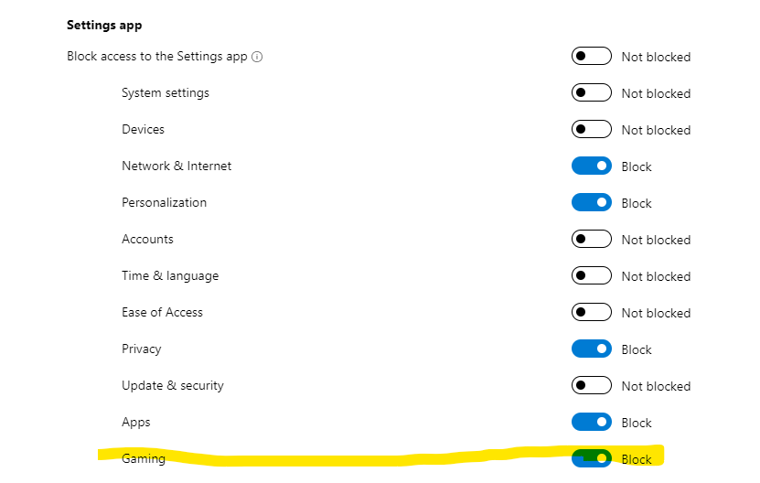
Bad ~ Really Just Annoying
Intune for Education
17

Slide 18
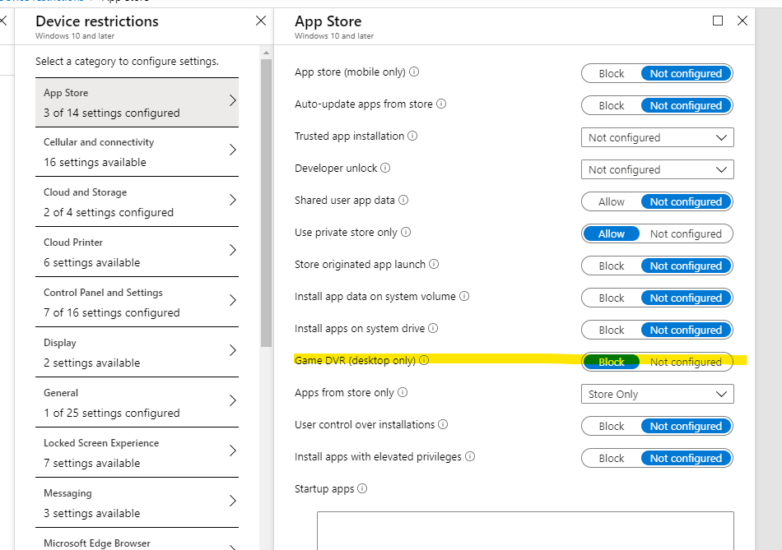
Bad ~ Really Just Annoying
"Big" Intune
Device Management
18

Slide 19

The OMG
LICENSING!!!
Reporting
Provisioning via Set up School PC App
Roll out Chrome ADMX
ADMX/GPO rollout w/o having devices in local AD
Legacy Apps Installation
Printer Installation
19

Slide 20
Tips
Separate Device and User Policies
Careful if using all devices or all user groups for policies
Default Policies for EDU – defaults to all devices unless unassign
Macrium Reflect - Free Edition for making bootable USB drives
Test, test, test
1

Slide 21
Would you do it again ~ staying with MS?
YES!!
Changes for 2020-2021
License change ?????
Redo Group Structure for Devices
Chrome Policies (hopefully via Intune)
Utilize MS new Chromium based Edge & it's management
Use SIS Data Sync to leverage OneNote, Teams, etc
Understand/leverage MS administration –
permissions, sharing monitoring, etc....
MS needs to hold summits/trainings like Google
1

Slide 22
Questions?
Thank you!!!
1

